Slide 1
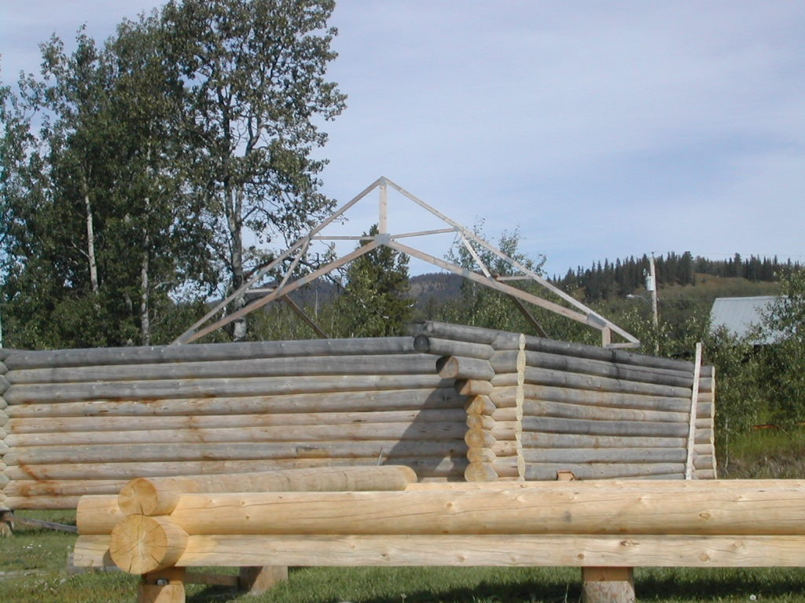
British Columbia Truss Plant
Technical Session
2014
WESTERN WOOD TRUSS ASSOCIATION
of BRITISH COLUMBIA

Slide 2
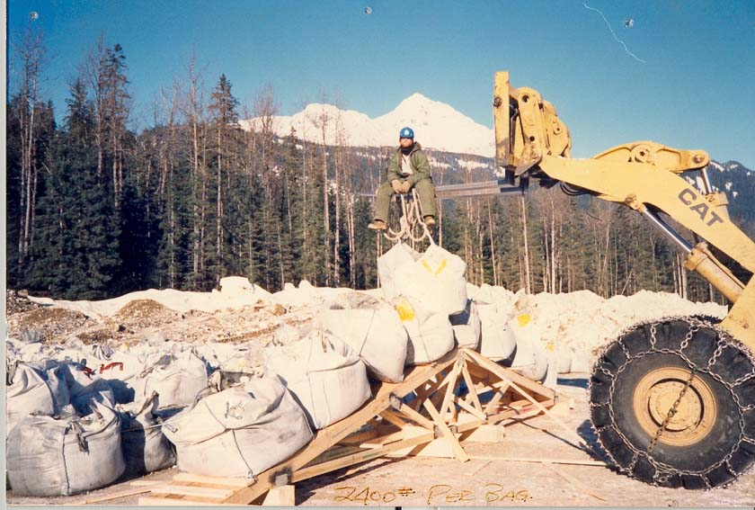
Large Scale Test

Slide 3
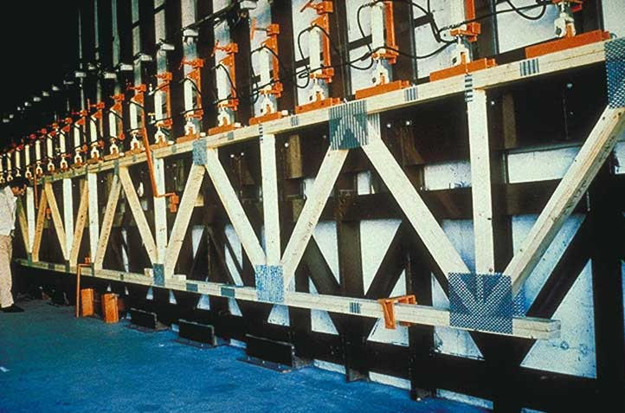
Large Scale Test

Slide 4
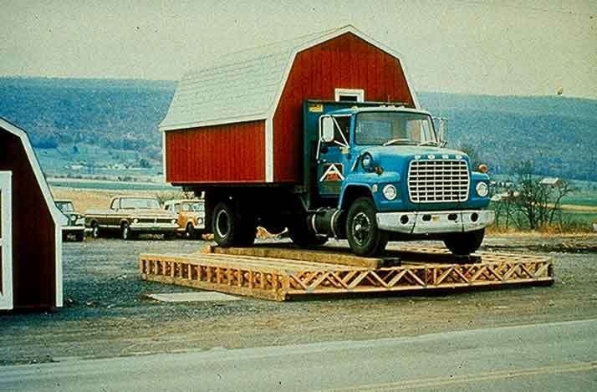
Larger Scale Test

Slide 5
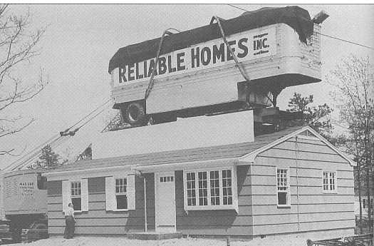
Full Scale Test

Slide 6
Most Attention???

Slide 7
PLATES
PLATES
PLATES
PLATES
PLATES
PLATES
PLATES
PLATES
PLATES

Slide 8
Plate Positioning
Plates:
Type
Size
Embedment
Positioning

Slide 9
Plates

Slide 10
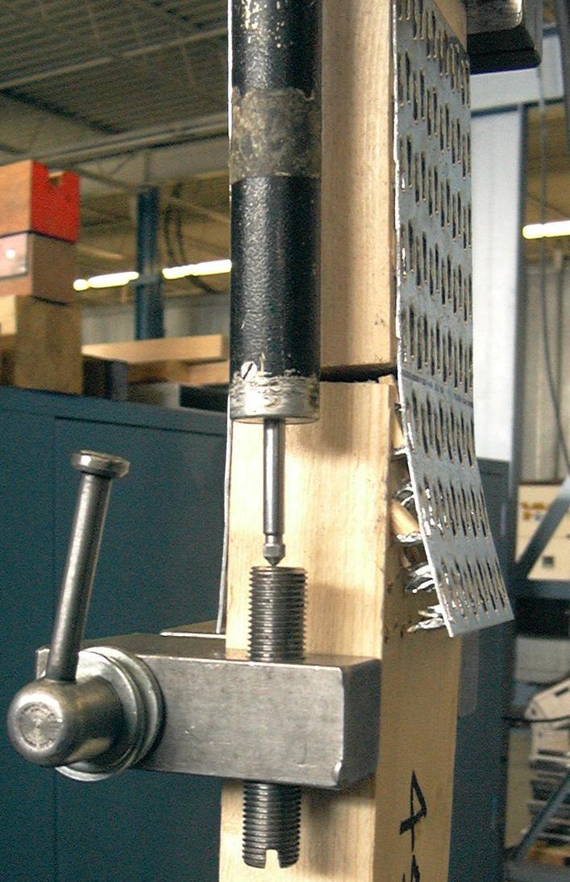
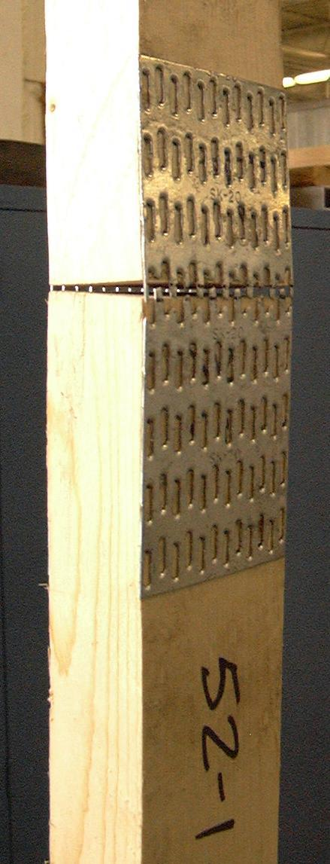
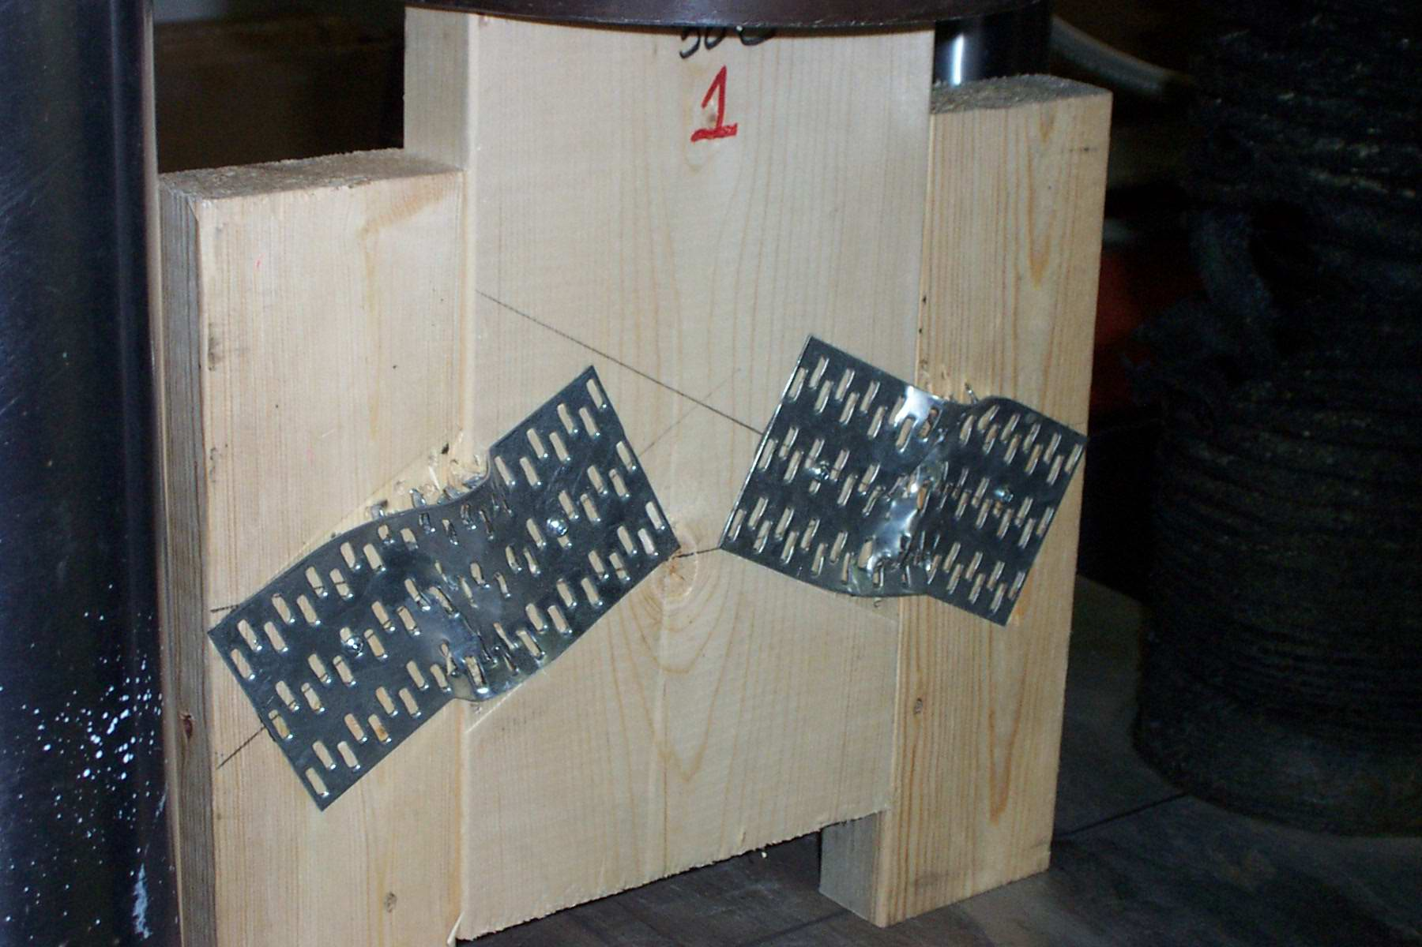
Plates - 3 Functions
Plate Grip Steel Tension Steel Shear

Slide 11
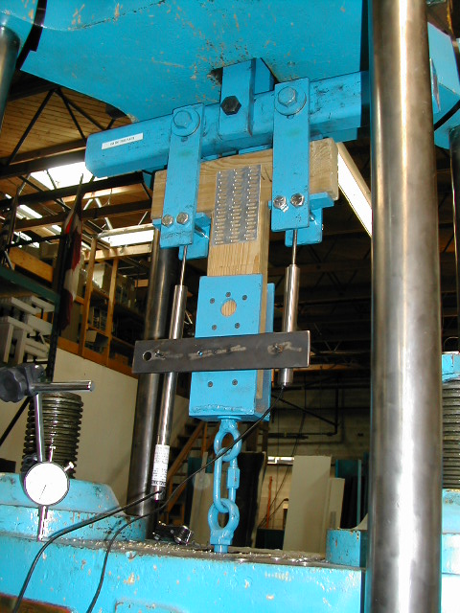
Plate Test

Slide 12
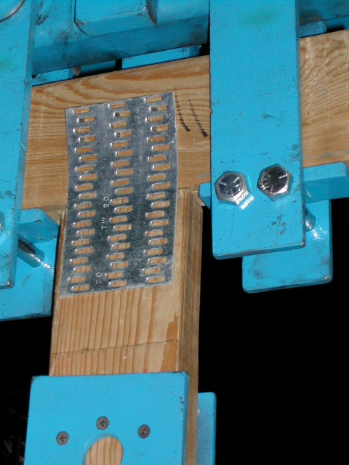
Plate Test

Slide 13
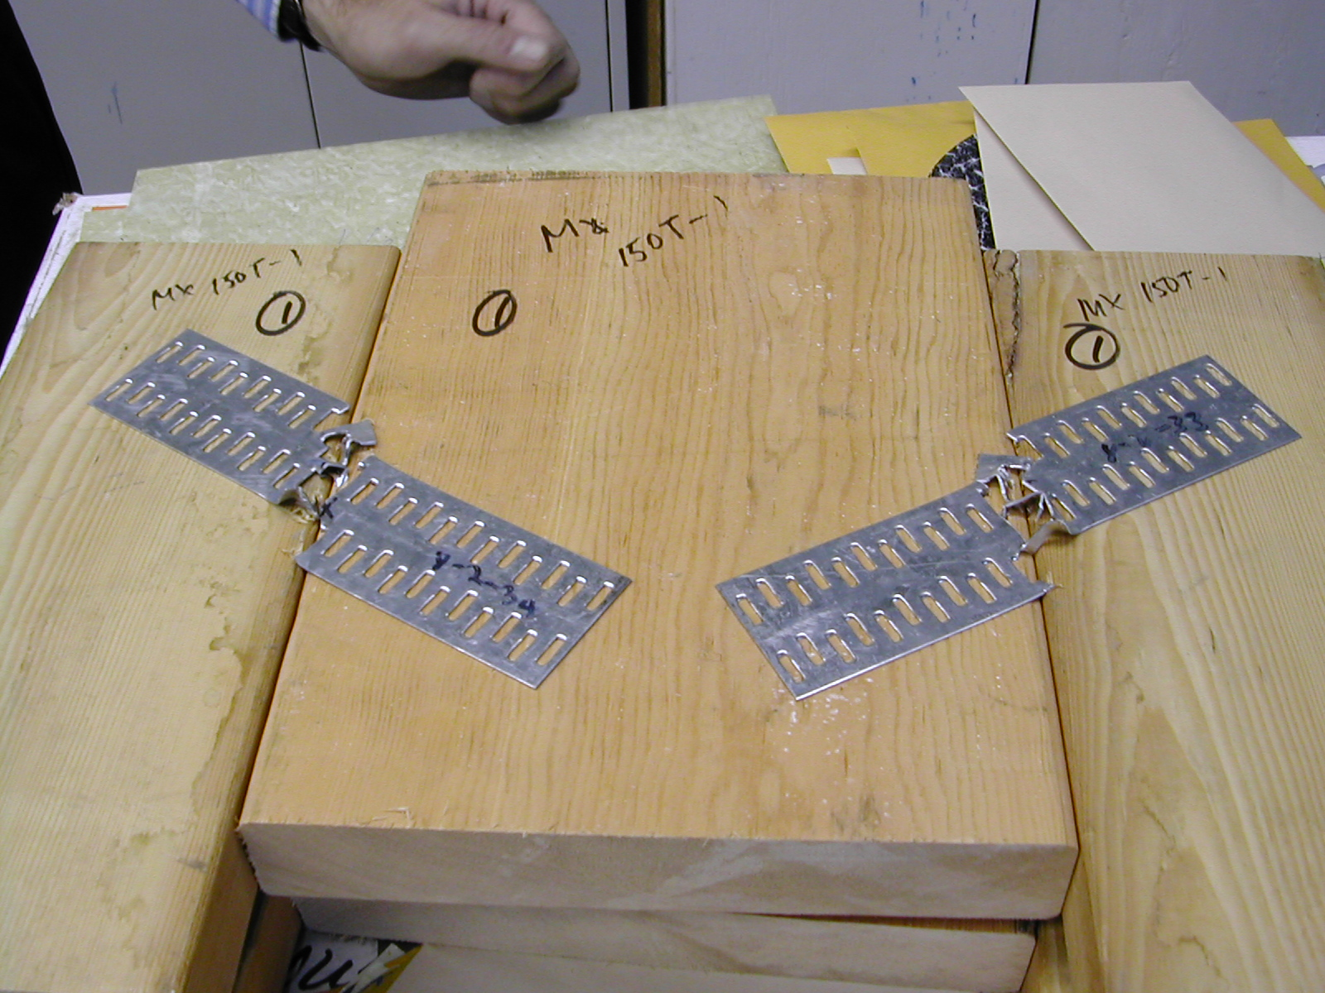
Shear Test

Slide 14
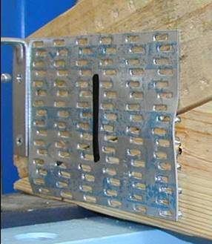
Heel Test (Shear)

Slide 15
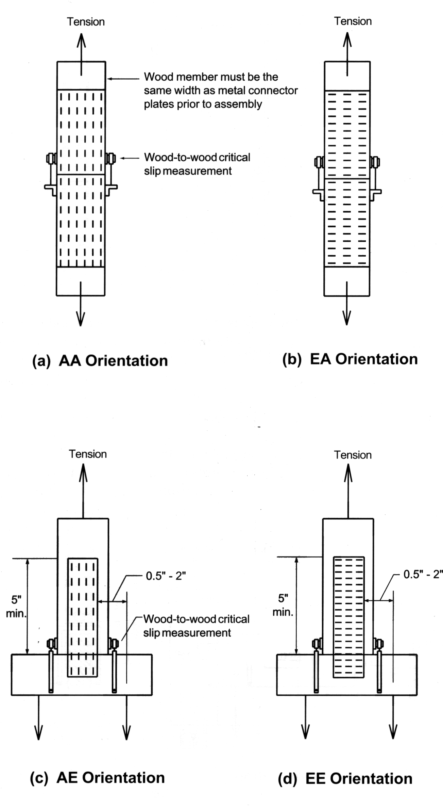
Test Orientation

Slide 16
Effective Plate Contact Area

Slide 17
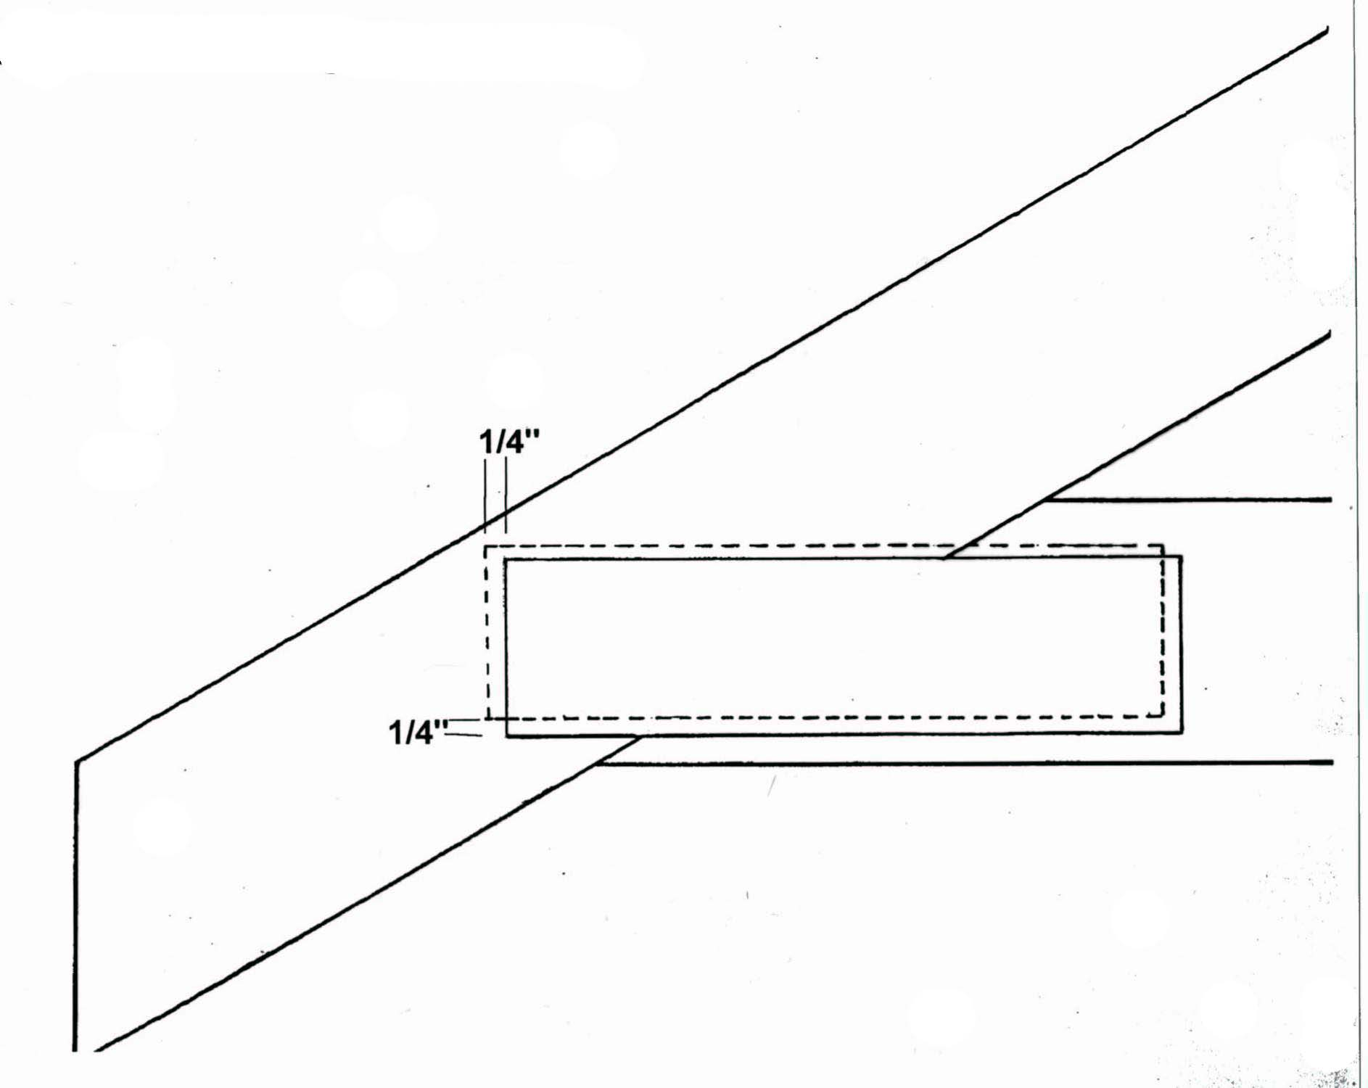
Plate Positioning Tolerance

Slide 18
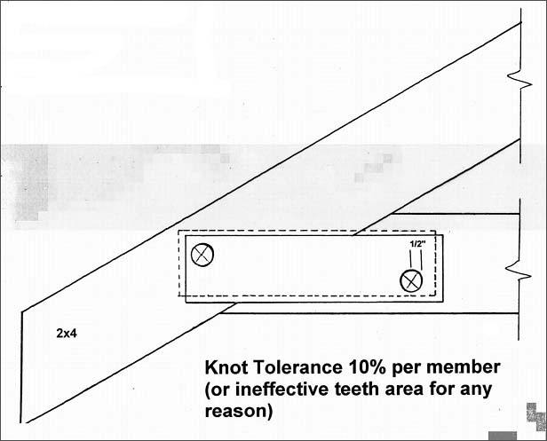
Knot Tolerance

Slide 19
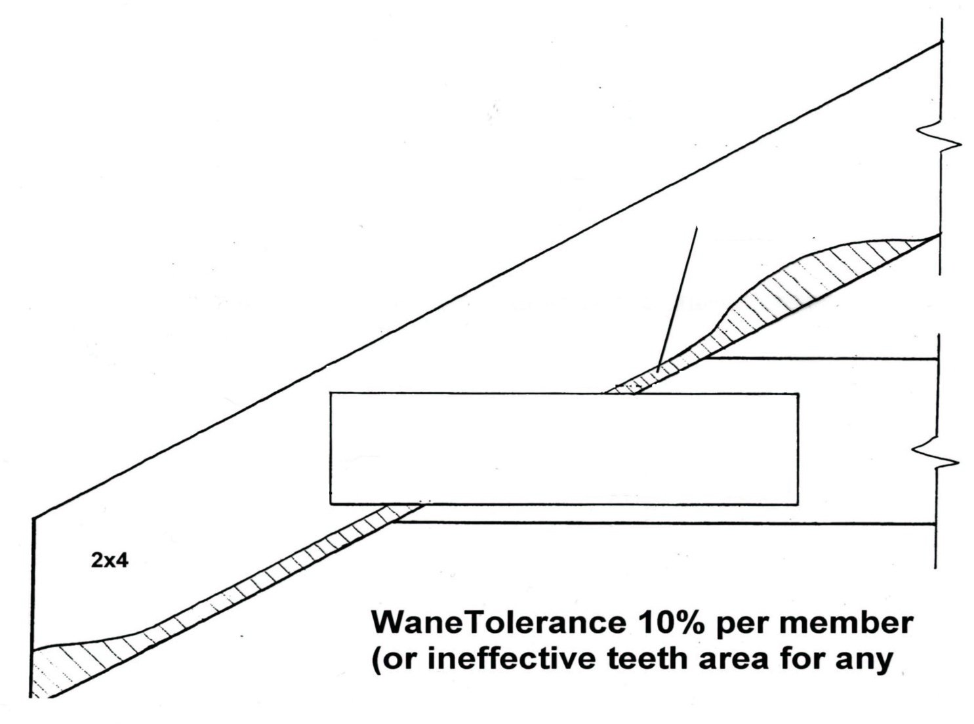
Wane Tolerance

Slide 20
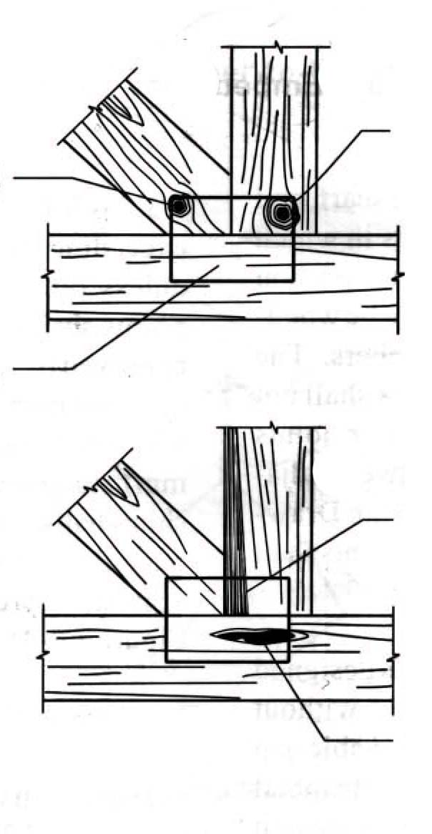
Effective Plate Contact Area
?
?
10% defective per piece
i.e. 90%
effective
?
?
?

Slide 21
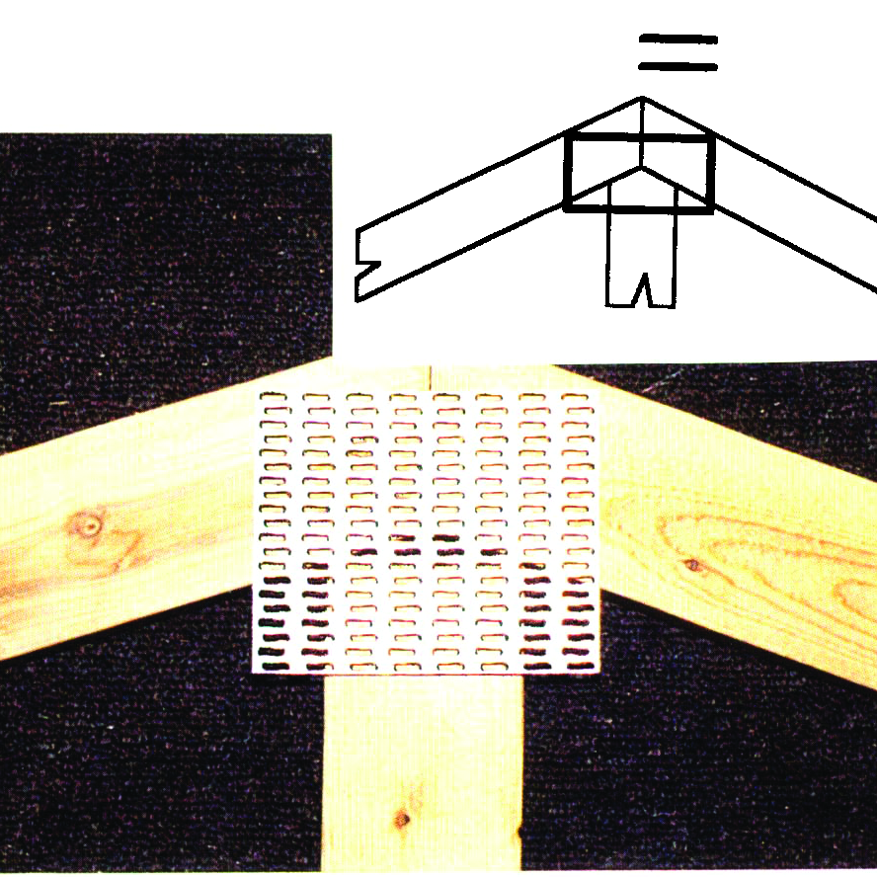
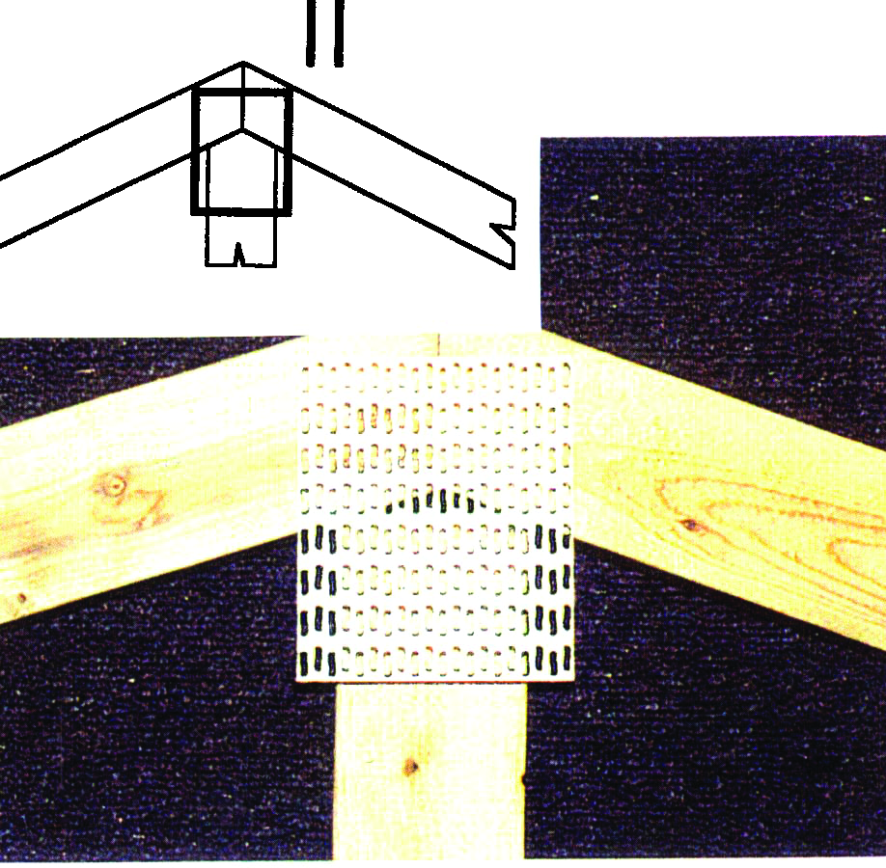
Plate Positioning

Slide 22
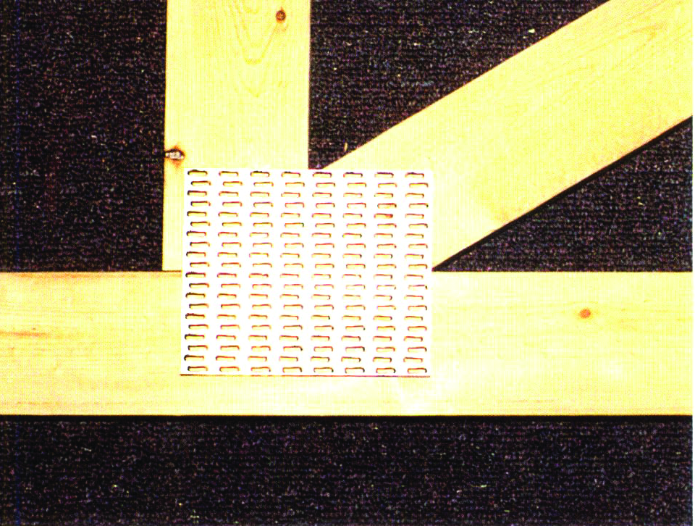
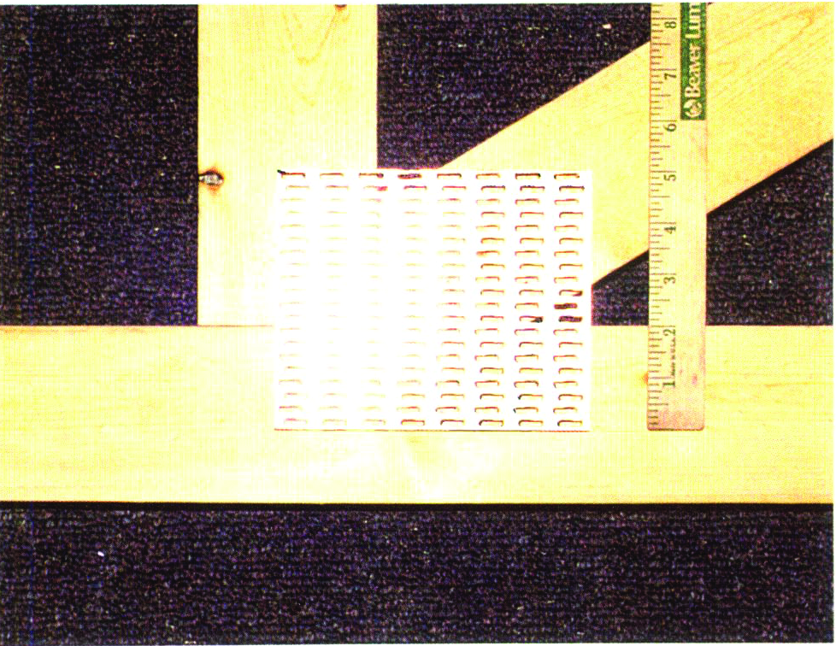
Plate Positioning

Slide 23
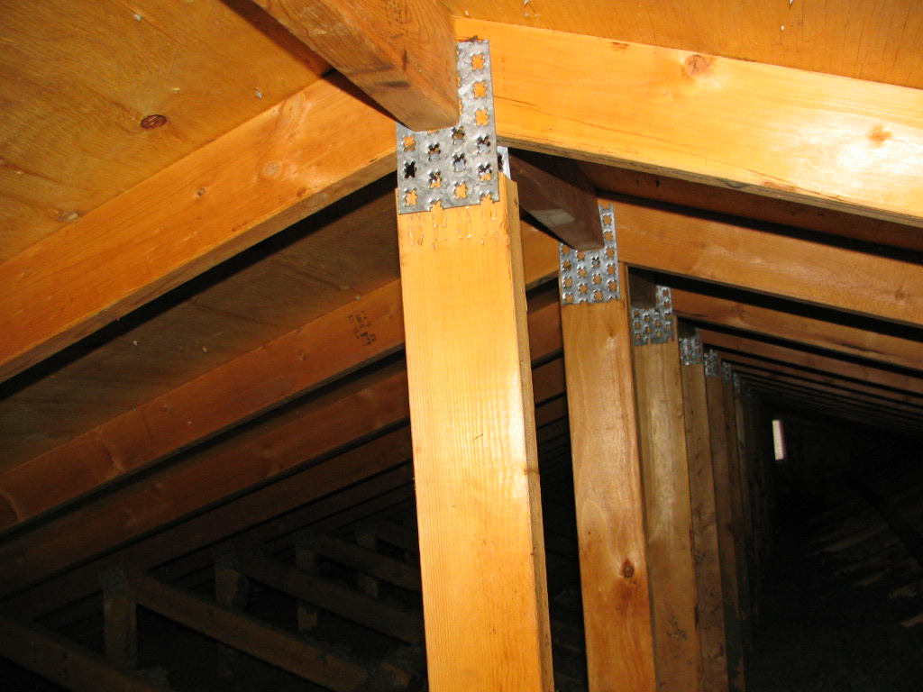
Plate Positioning

Slide 24
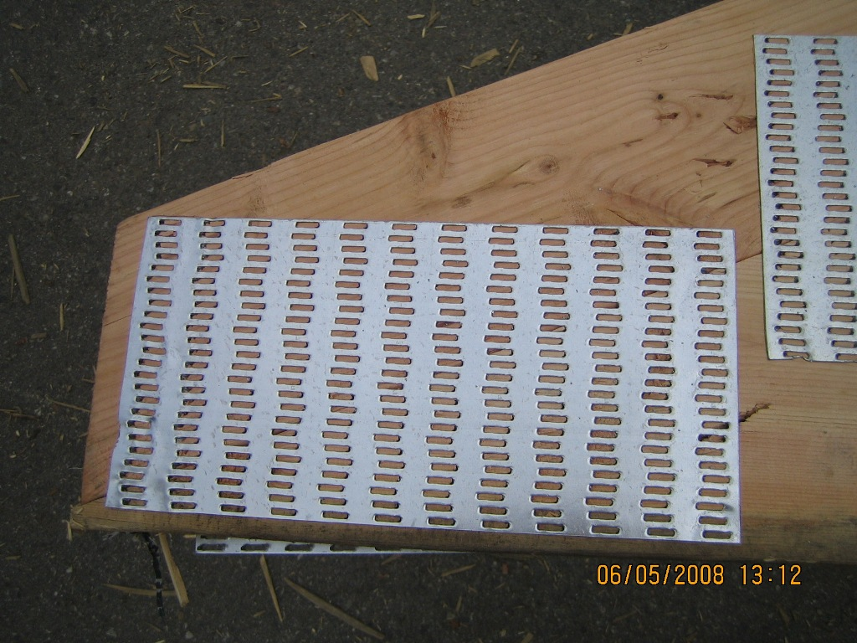
Interfering

Slide 25
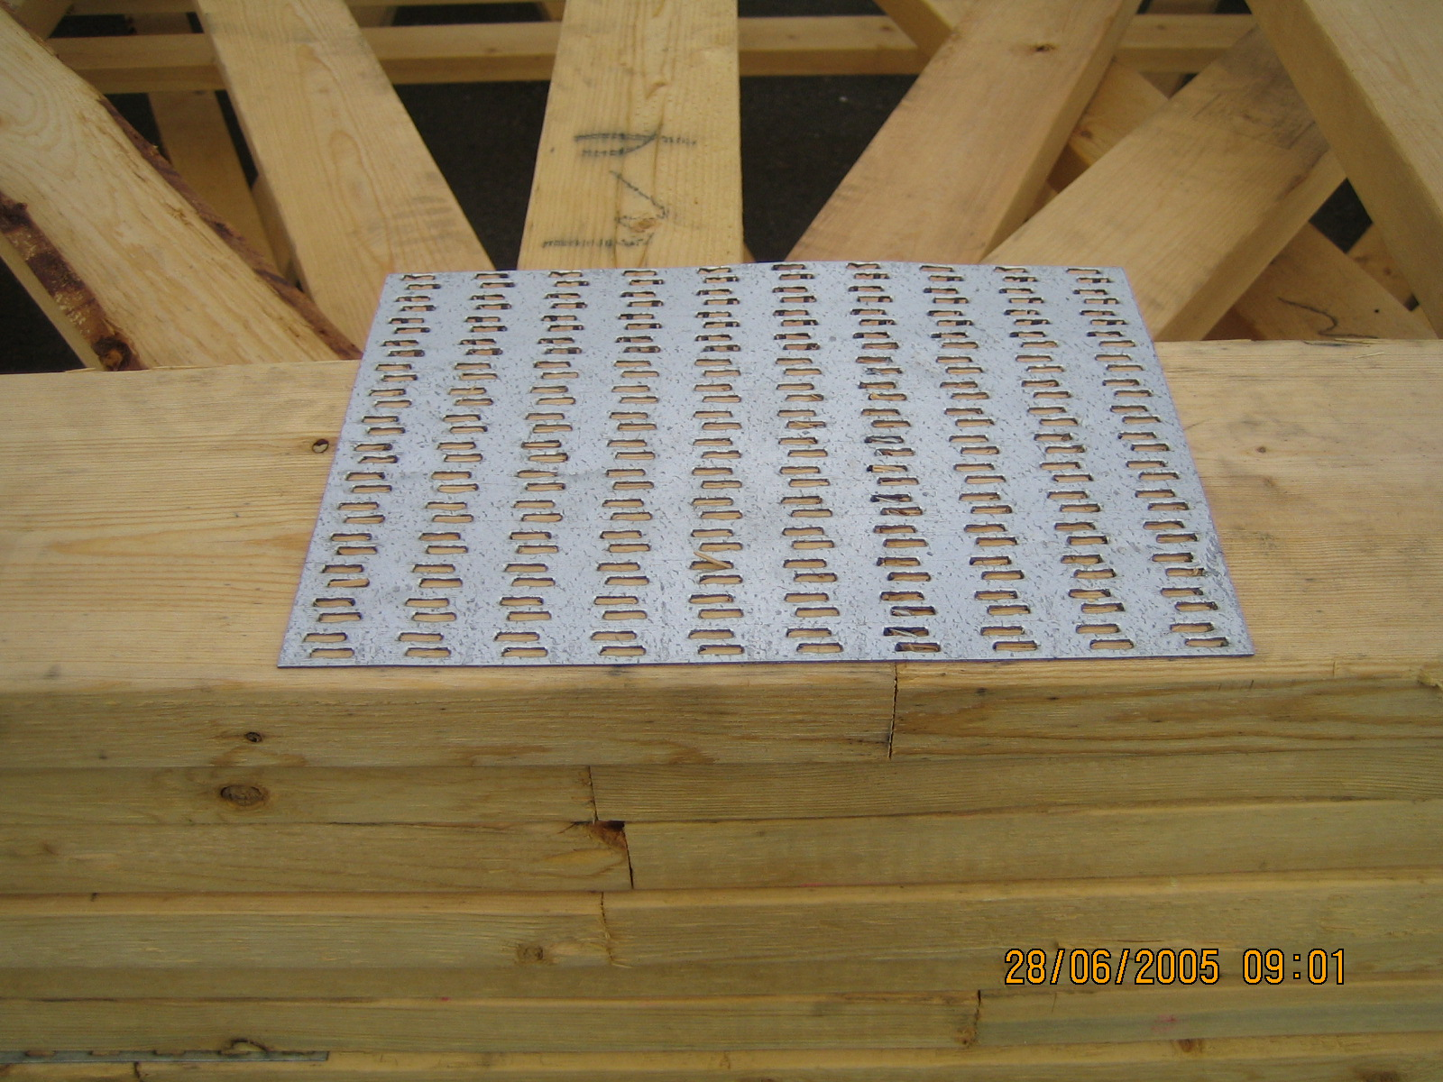
???

Slide 26
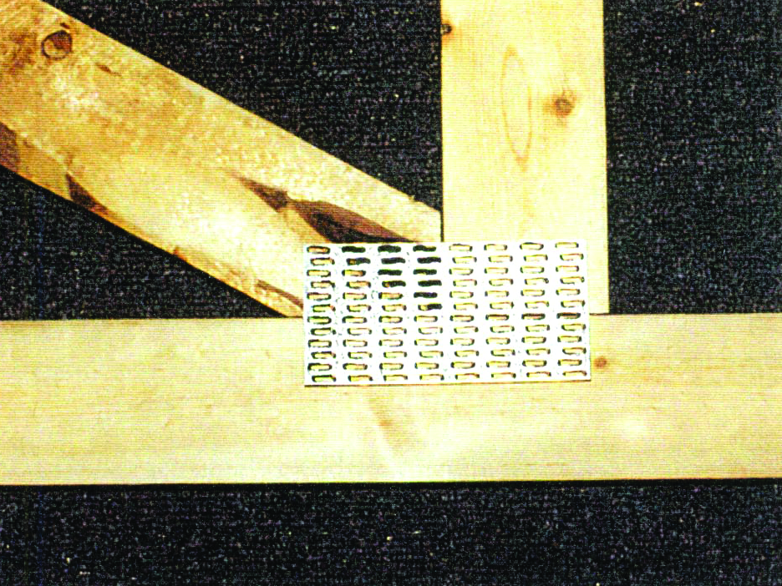
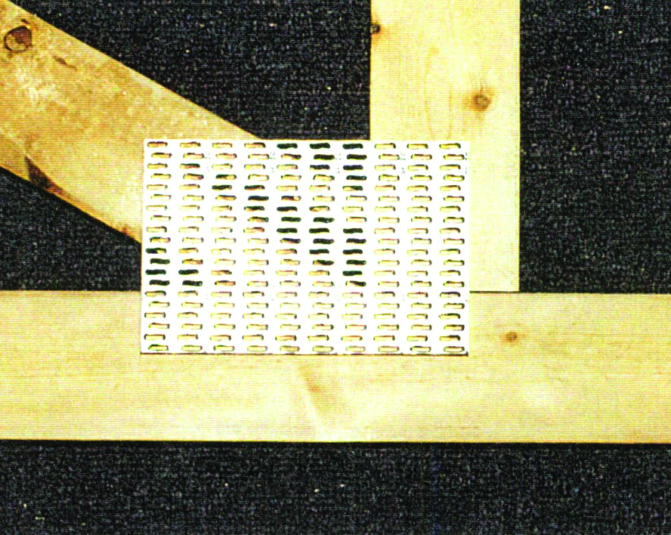
Pitch Pocket

Slide 27
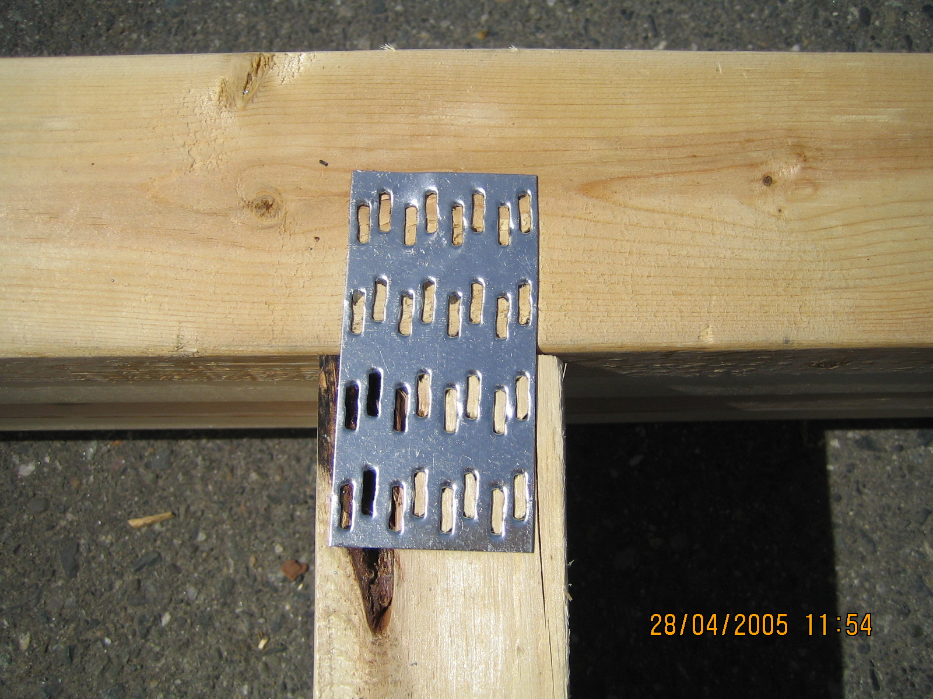
Wood – Bark Pocket

Slide 28
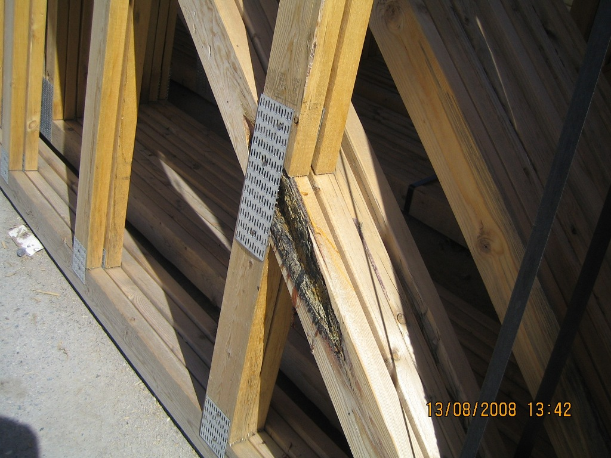
Pitch Pocket… Teeth?

Slide 29
Effective Plate Contact Area - Wane

Slide 30
Tooth Embedment
Embedment Gap Effectiveness Card(s)
O” to less than 1/32” 100% 0
1/32” to less than 1/16” 60% 1
> 1/16” 0% 2
If you can insert a credit card, then at best, only 60% of required gripping power remains.

Slide 31
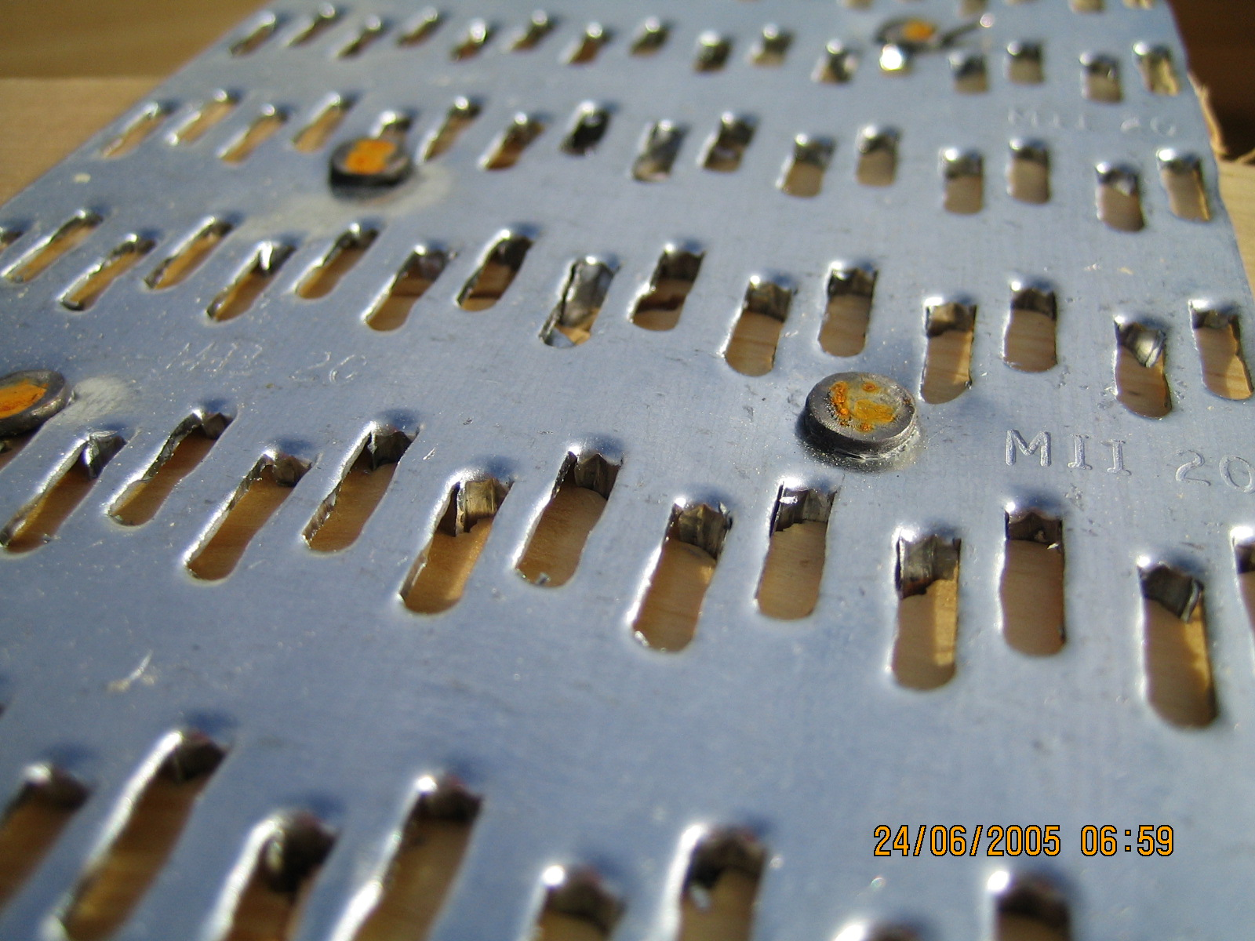
Lack of Embedment

Slide 32
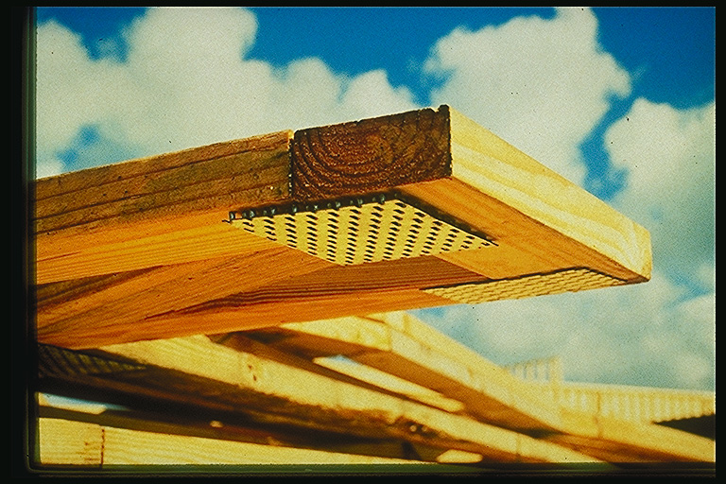
Plate Embedment

Slide 33
Plate Embedment

Slide 34
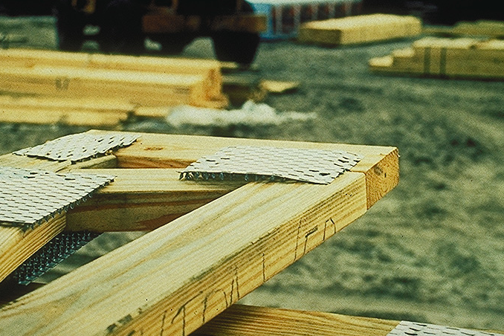
Plate Embedment

Slide 35
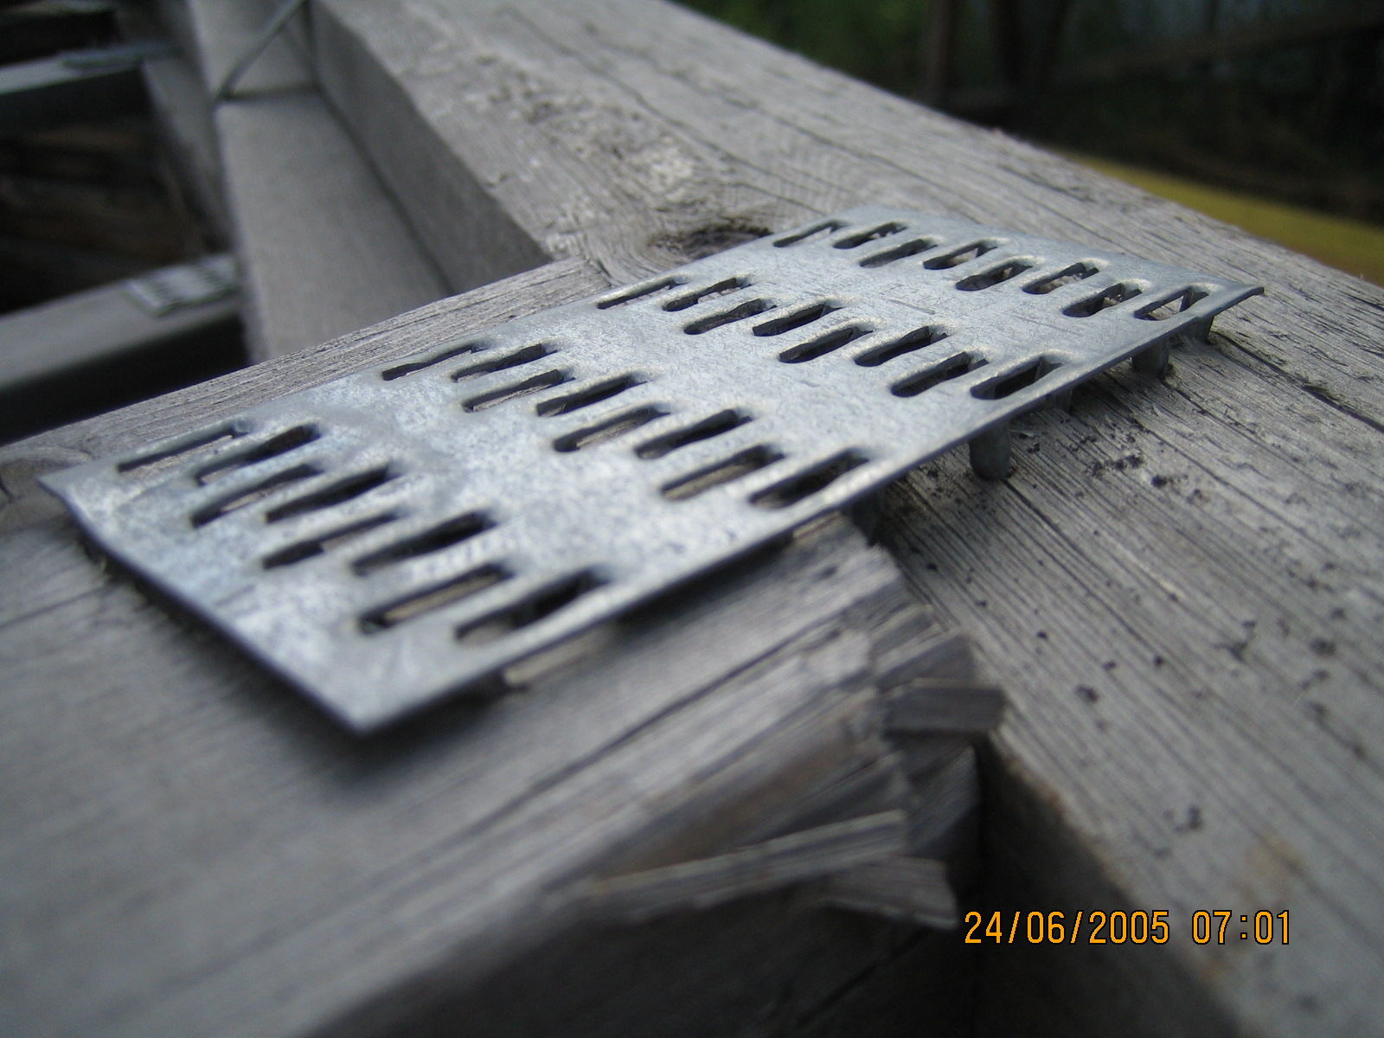
Weather

Slide 36
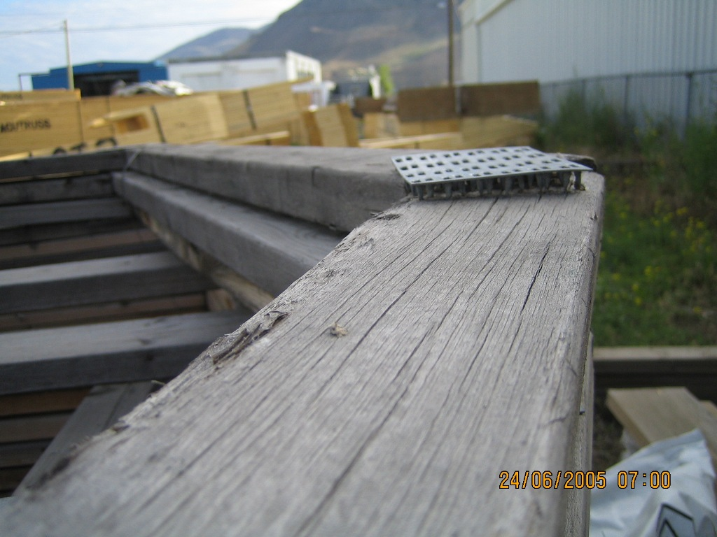
Weather

Slide 37
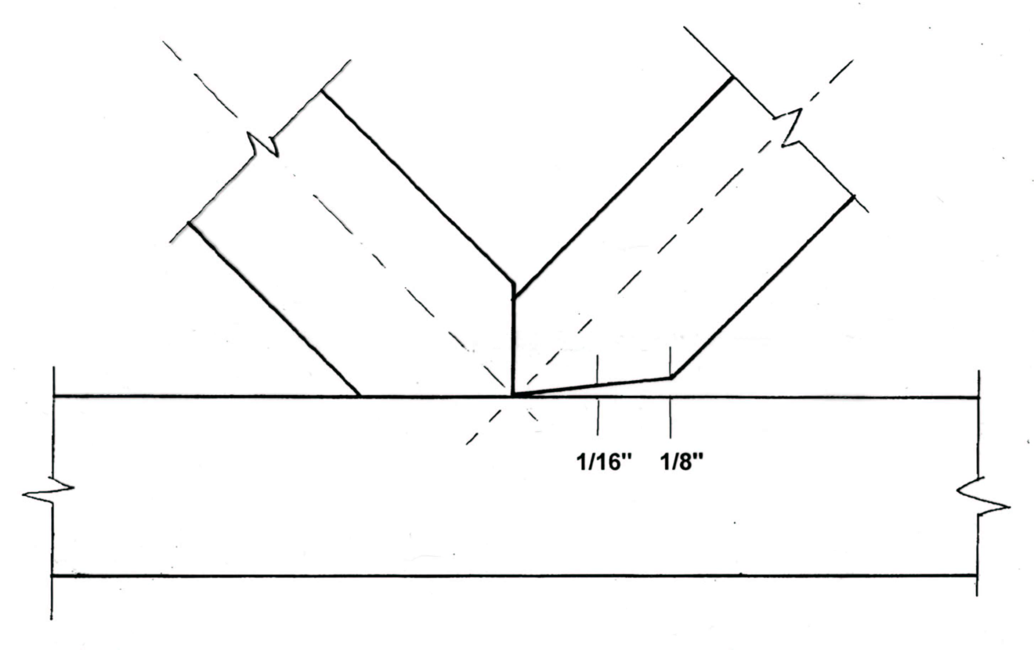
Wood-Wood Joint Tolerance

Slide 38
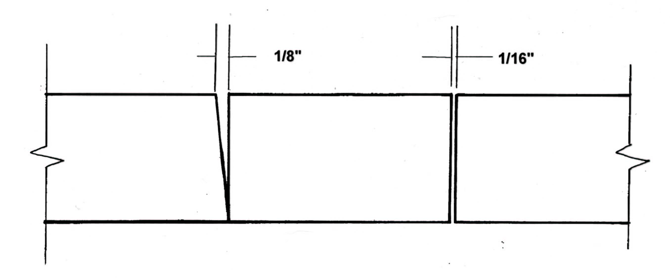
Bottom Chord Splice
Wood – Wood Gap

Slide 39
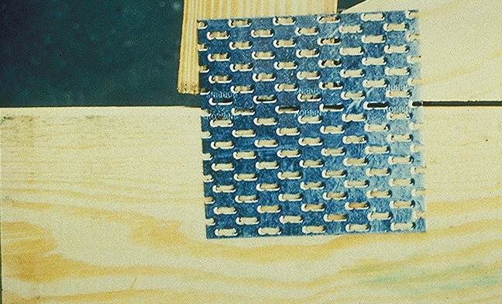
Wood-Wood Gap

Slide 40
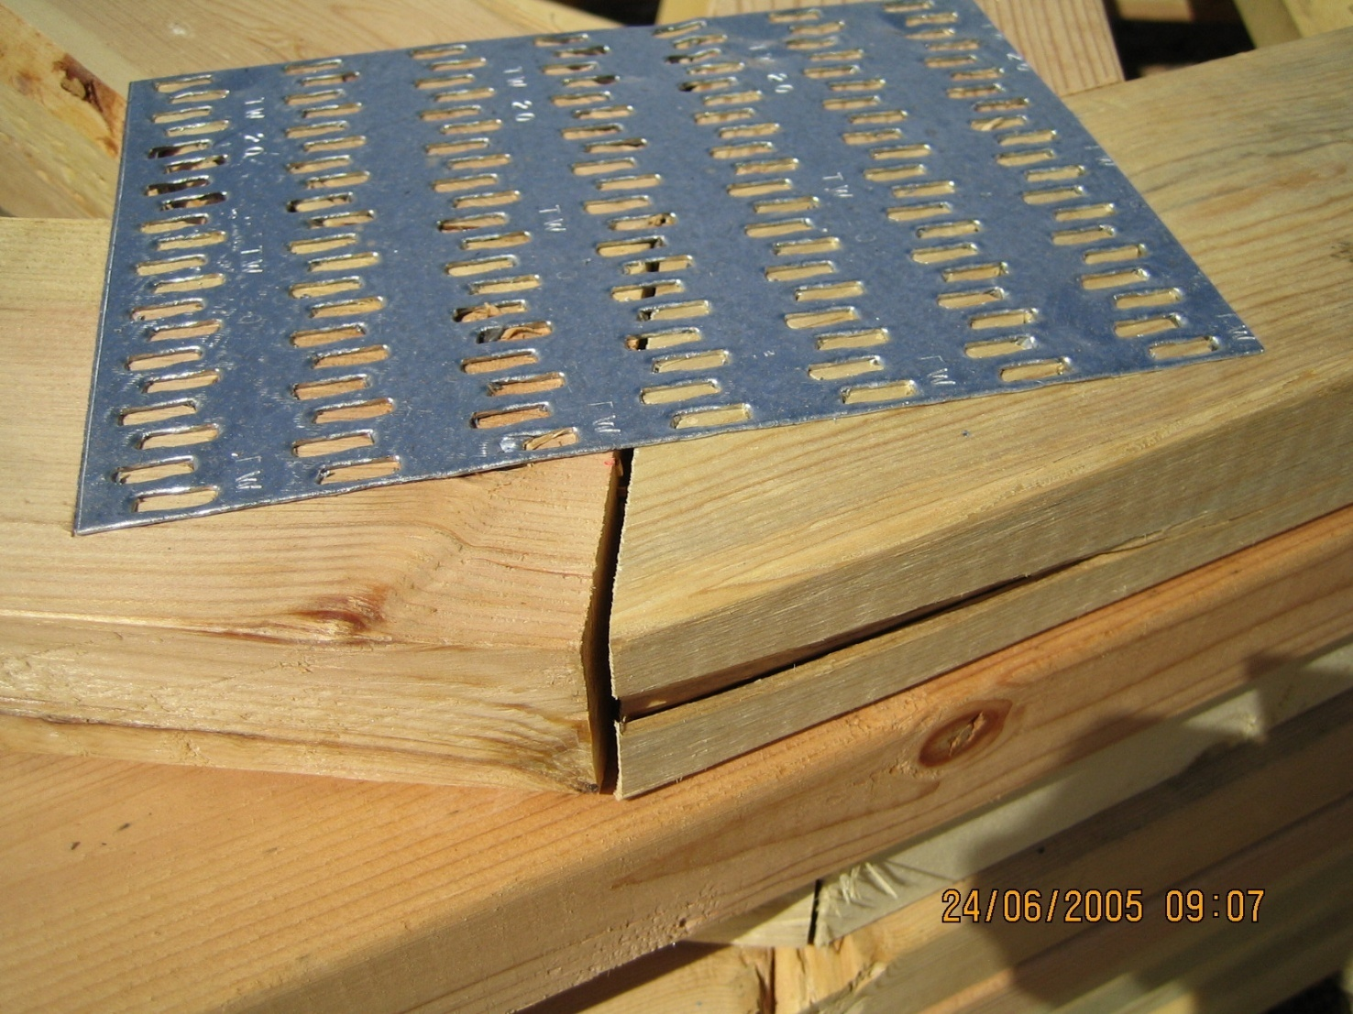
Wood-Wood Gap

Slide 41
Top Chord Splice ?
Snug

Slide 42
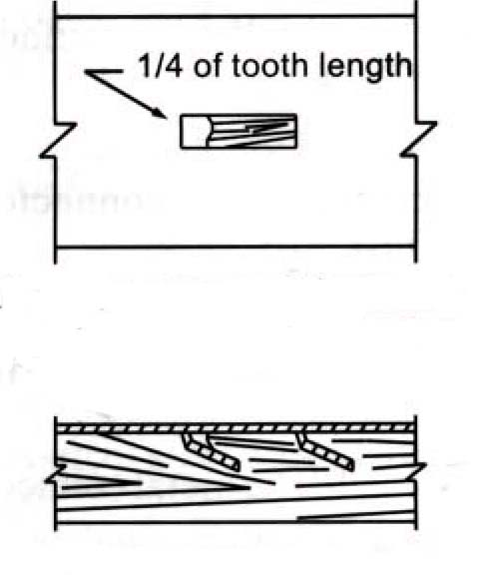
Tooth Flattening
If you see ¼ length, then “ineffective”.
One tooth seen as flat
= two teeth “ineffective”.

Slide 43
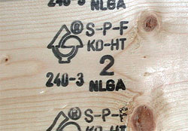
Gradestamp

Slide 44
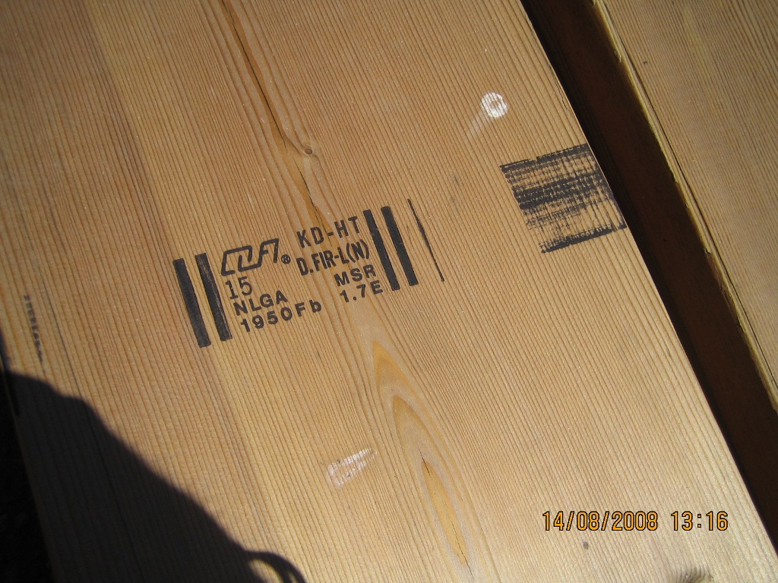
Gradestamp

Slide 45
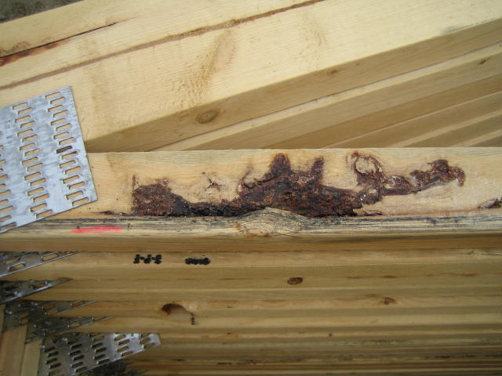
Pitch & Shake?

Slide 46
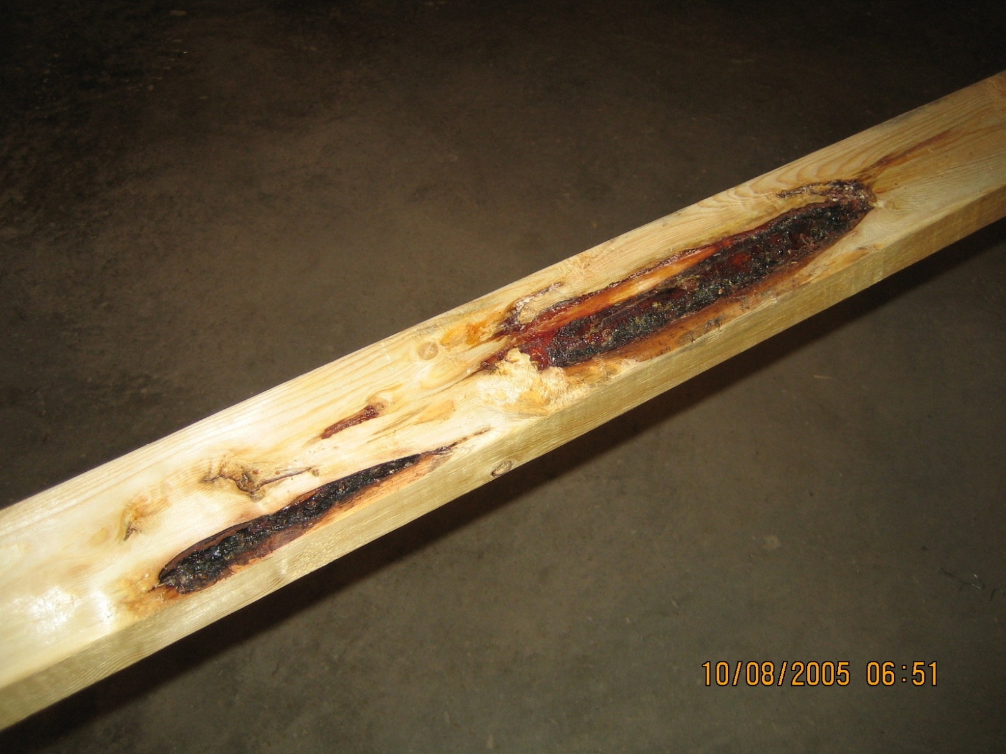
Pitch

Slide 47
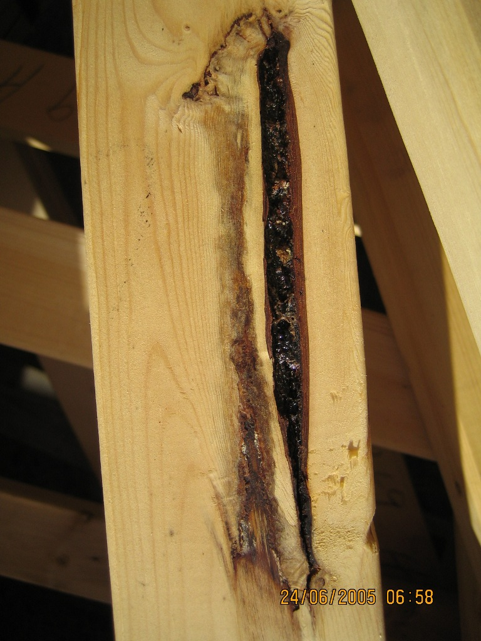
Pitch

Slide 48
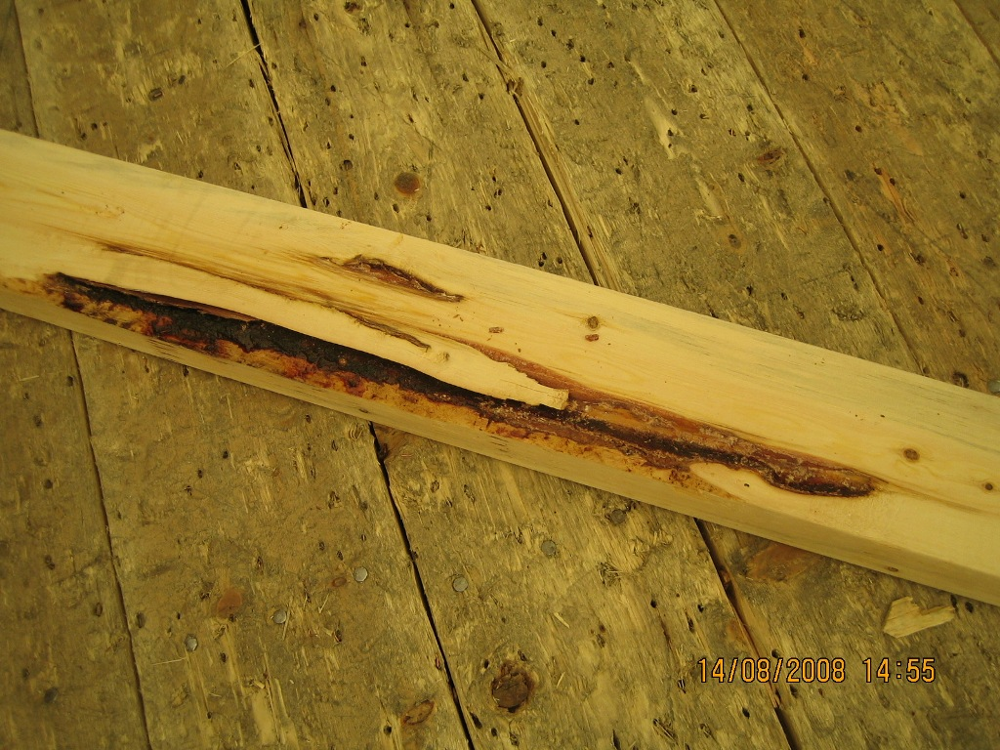
Pitch/Wane

Slide 49
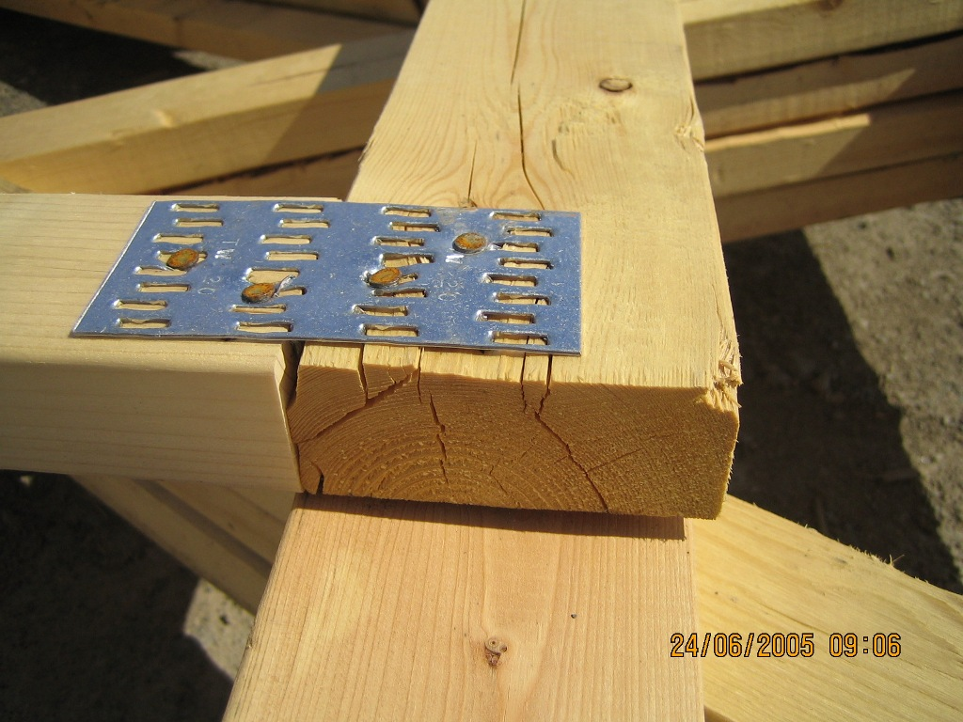
Split (s) - how many?

Slide 50
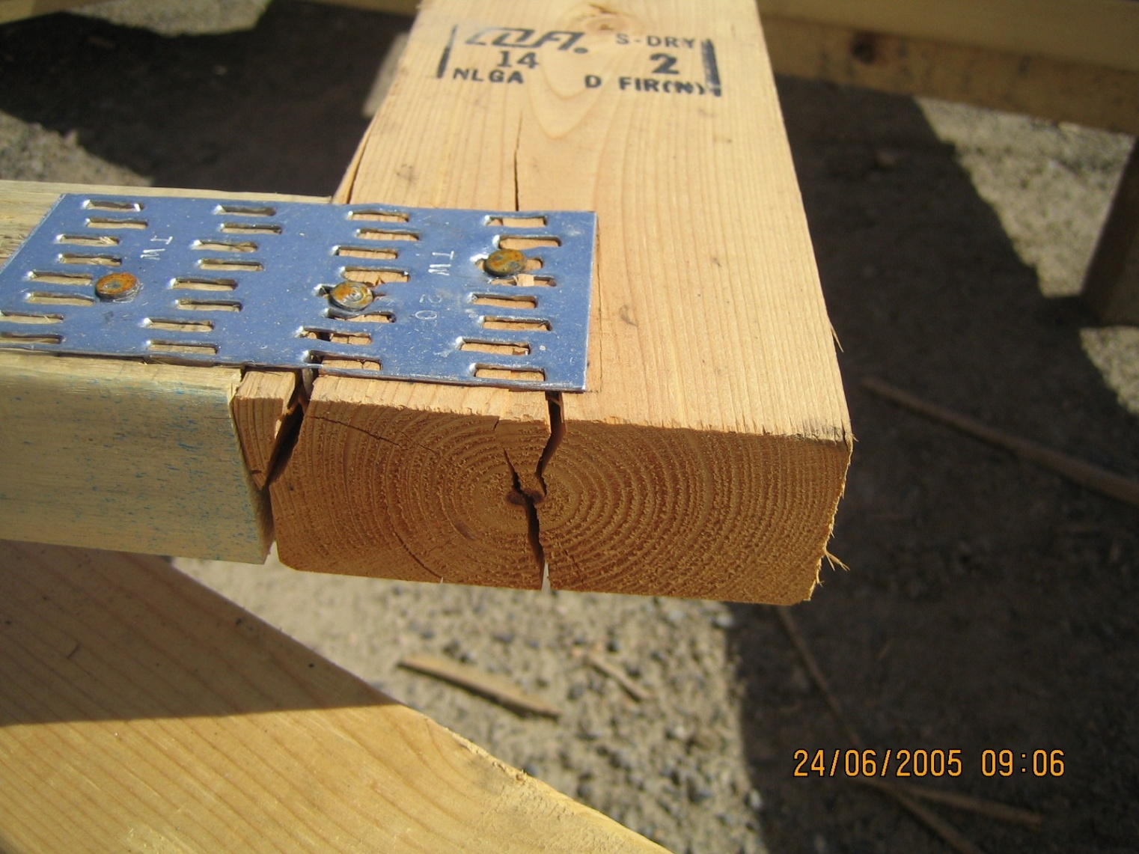
Split

Slide 51
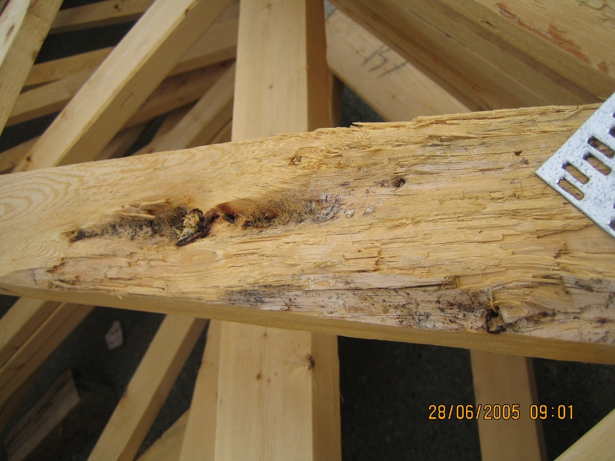
Scant

Slide 52
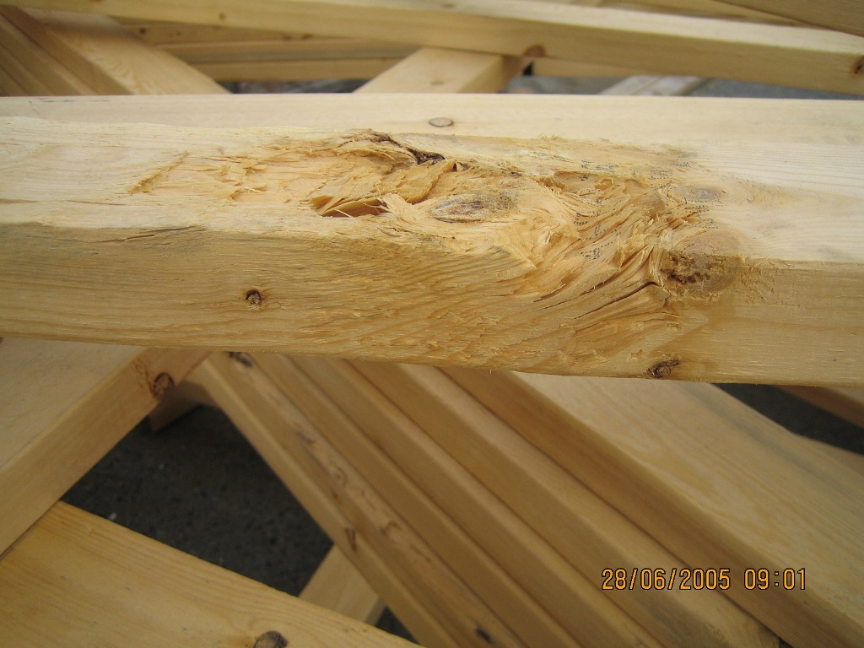
Wood…

Slide 53
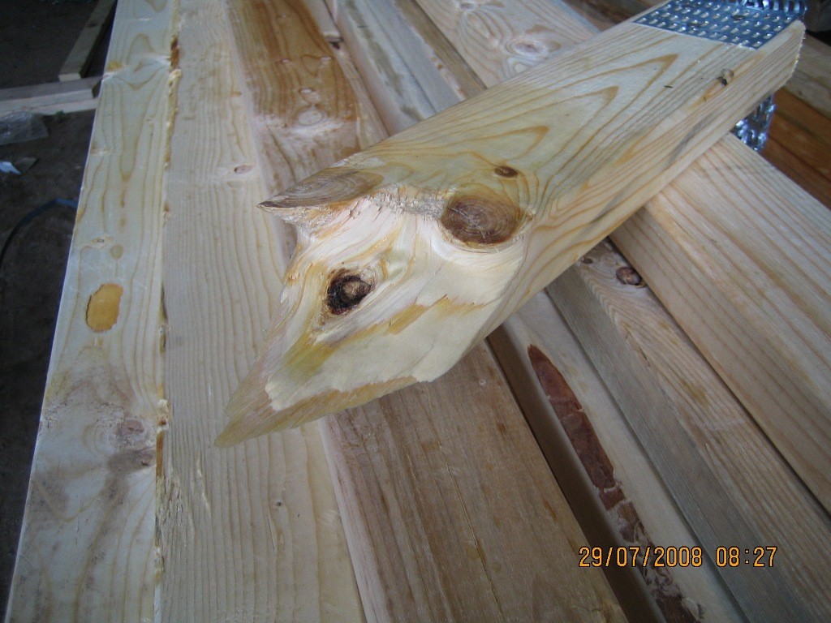
Wood…. Slope of Grain/Brash

Slide 54
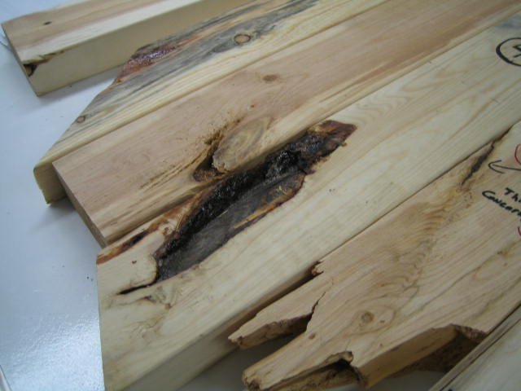
Wood

Slide 55
Wood

Slide 56
Please Scab

Slide 57
Decay?

Slide 58
Decay?

Slide 59
Oops

Slide 60
Oops - oops

Slide 61
Missing

Slide 62
Bad Truss

Slide 63
Questions?

Slide 64
END

